Slide 1
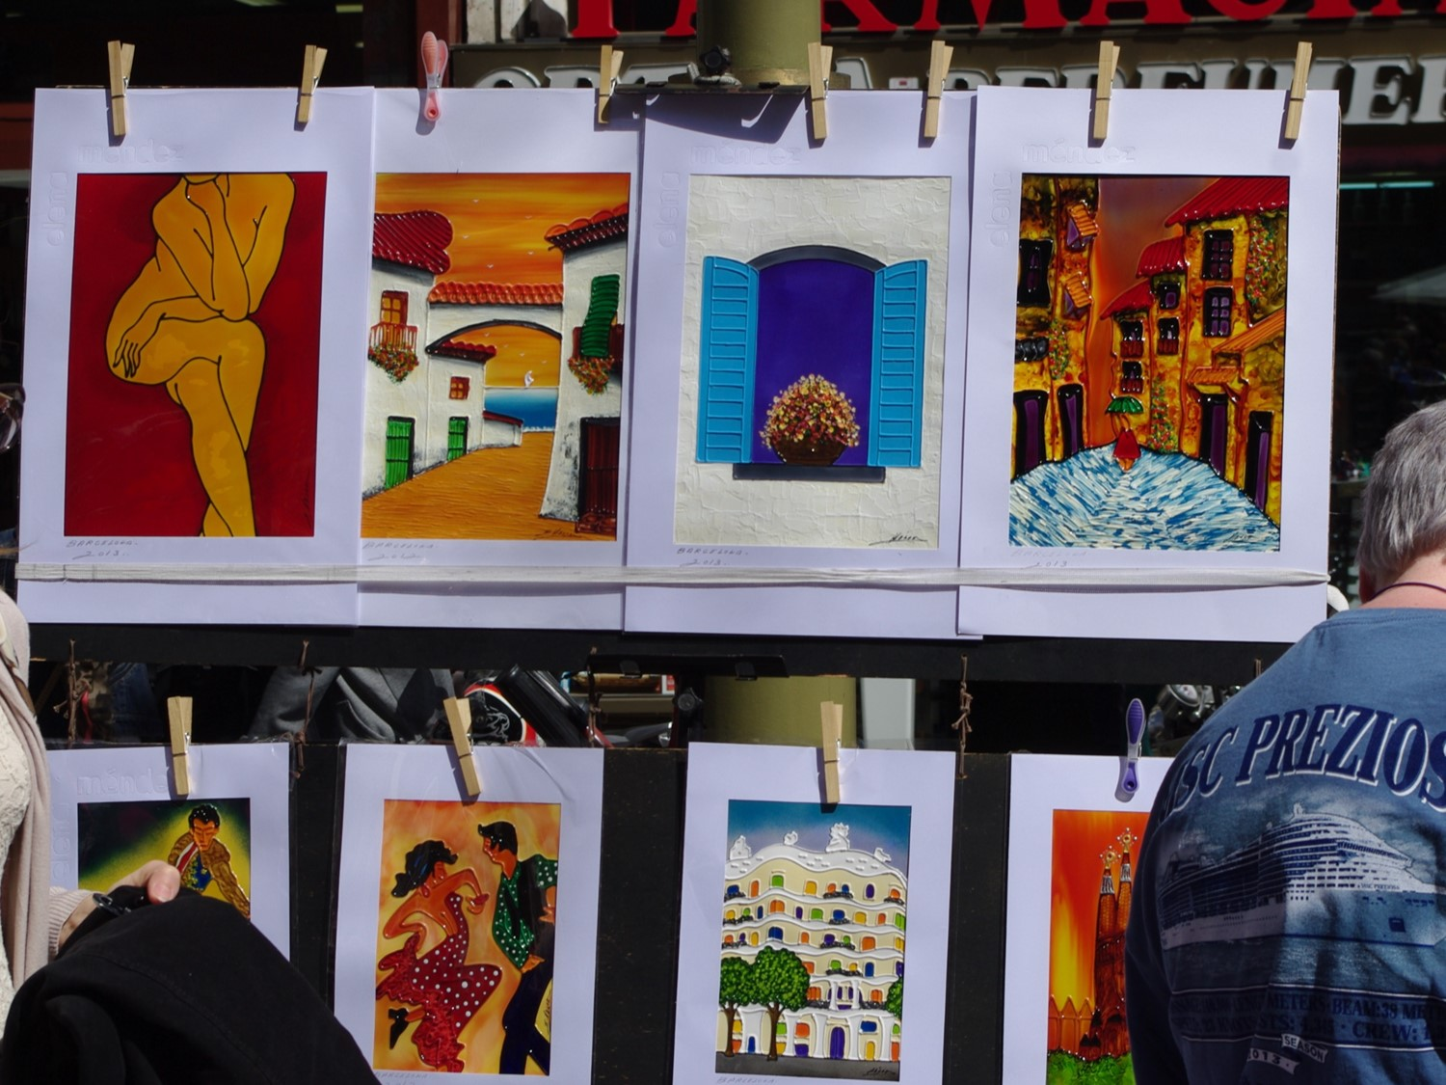
DATA MANAGEMENT, «FAIR» DATA, EOSC
Elena Giglia
Pisa, 9 maggio 2019
elena.giglia@unito.it
This work is licensed under a Creative Commons Attribution-ShareAlike 4.0 International License. Photos are mine, available for reuse on Flickr, https://www.flickr.com/photos/eg65/albums/

Slide 2
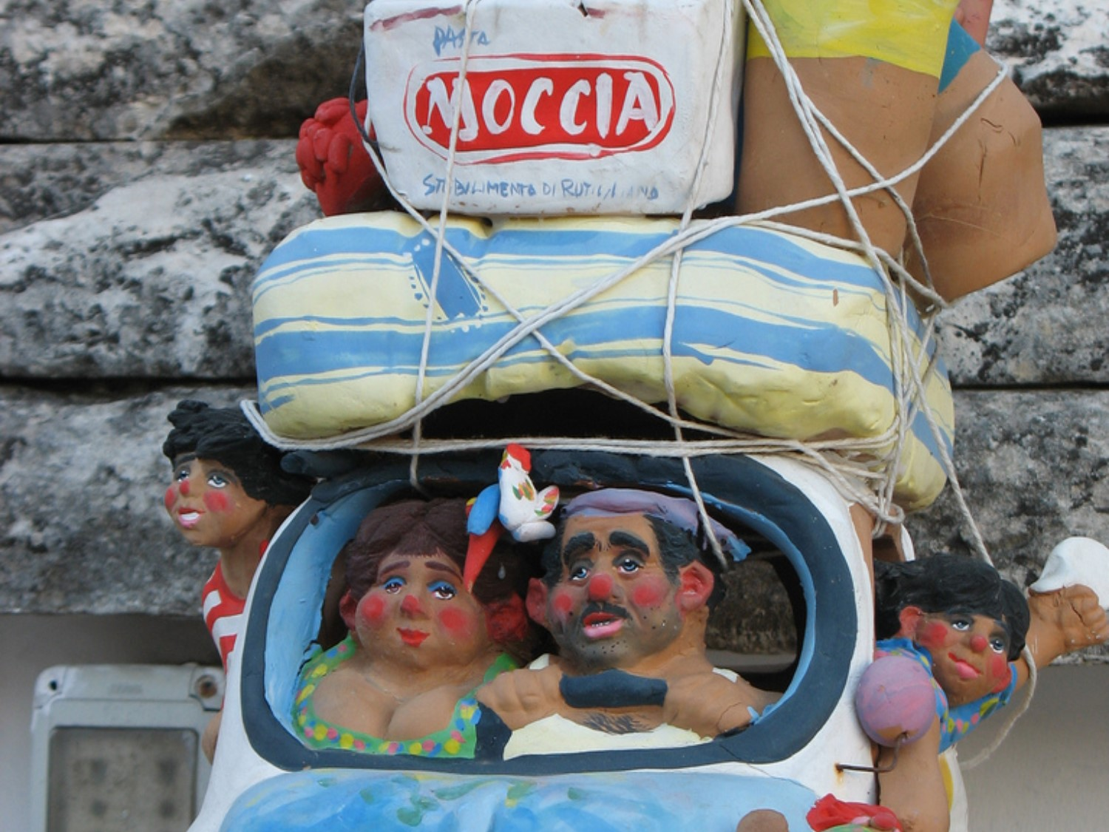
The road ahead today
…perché occuparci dei dati?
…managed, FAIR, Open: diversi
… DMP: uno strumento utile, non un peso
…corsi, servizi, strumenti per gestire i dati

Slide 3
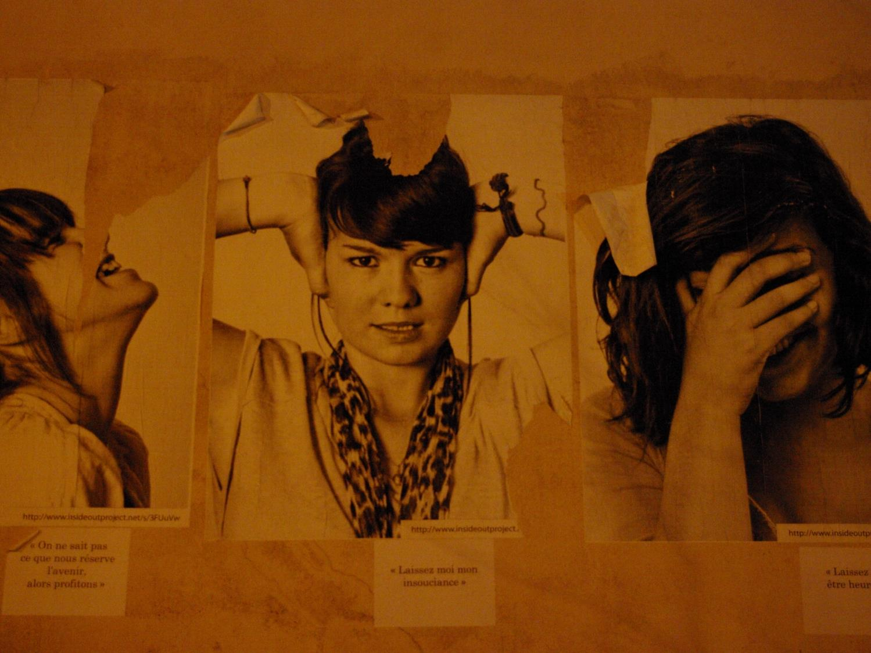
… lo so…
Non è facile gestire i dati
Non c’è una ricetta, ogni dataset unico
Ci sono molti aspetti da considerare
Molti strumenti da imparare a usare
Sembra richiedere così tanto tempo
Ma i benefici sono enoooooooooormi
AVVERTENZA PER L’USO
NON USCIRETE DI QUI OGGI CON UN DMP PRONTO [IMPOSSIBILE!]
MA CON GLI STRUMENTI UTILI PER SCRIVERLO – OGNUNO DIVERSO

Slide 4

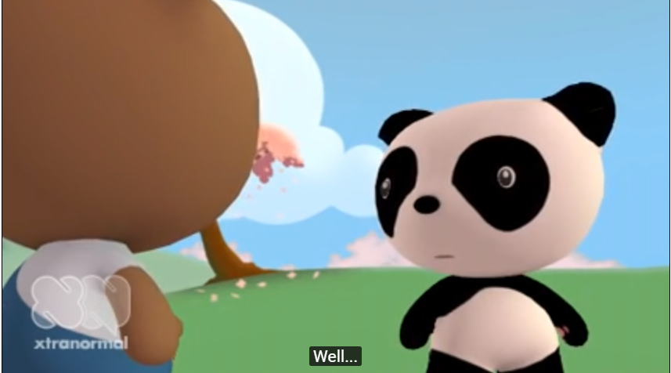
I dati. Perché vanno curati?
https://www.youtube.com/watch?v=N2zK3sAtr-4&ecver=2
… è l’incubo del data steward:
nessun backup
nessun software di accompagnamento
nessuna legenda dati
… e in più:
dati prodotti con fondi pubblici
pubblicati su Science che li richiede
utili a una ricercatrice di area diversa

Slide 5

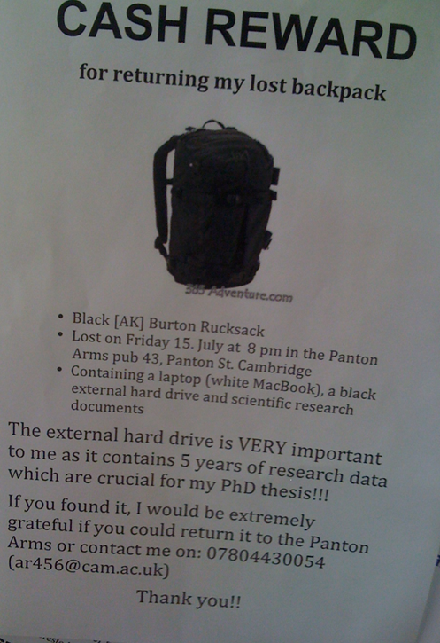
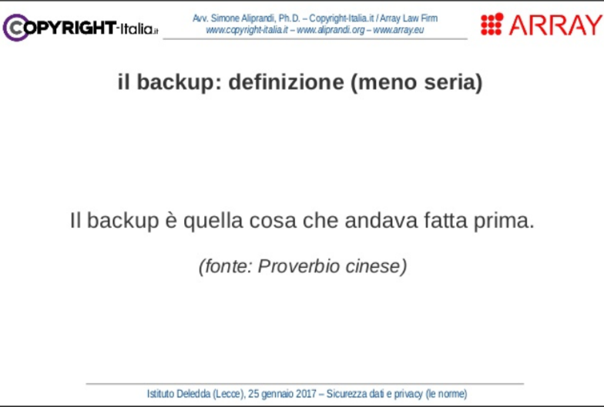
Perché i dati sono fragili / 1
PMRblog, 2011
S.Aliprandi, Sicurezza dati e privacy (le norme) 2017

Slide 6

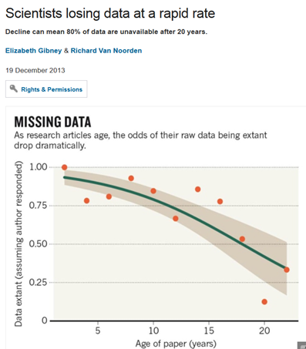
… i dati sono fragili
80% saranno persi in 20 anni
…ECCO A COSA SERVE IL
DATA MANAGEMENT PLAN.
NON È SOLO L’ENNESIMA NOIA BUROCRATICA
http://www.nature.com/news/scientists-losing-data-at-a-rapid-rate-1.14416

Slide 7
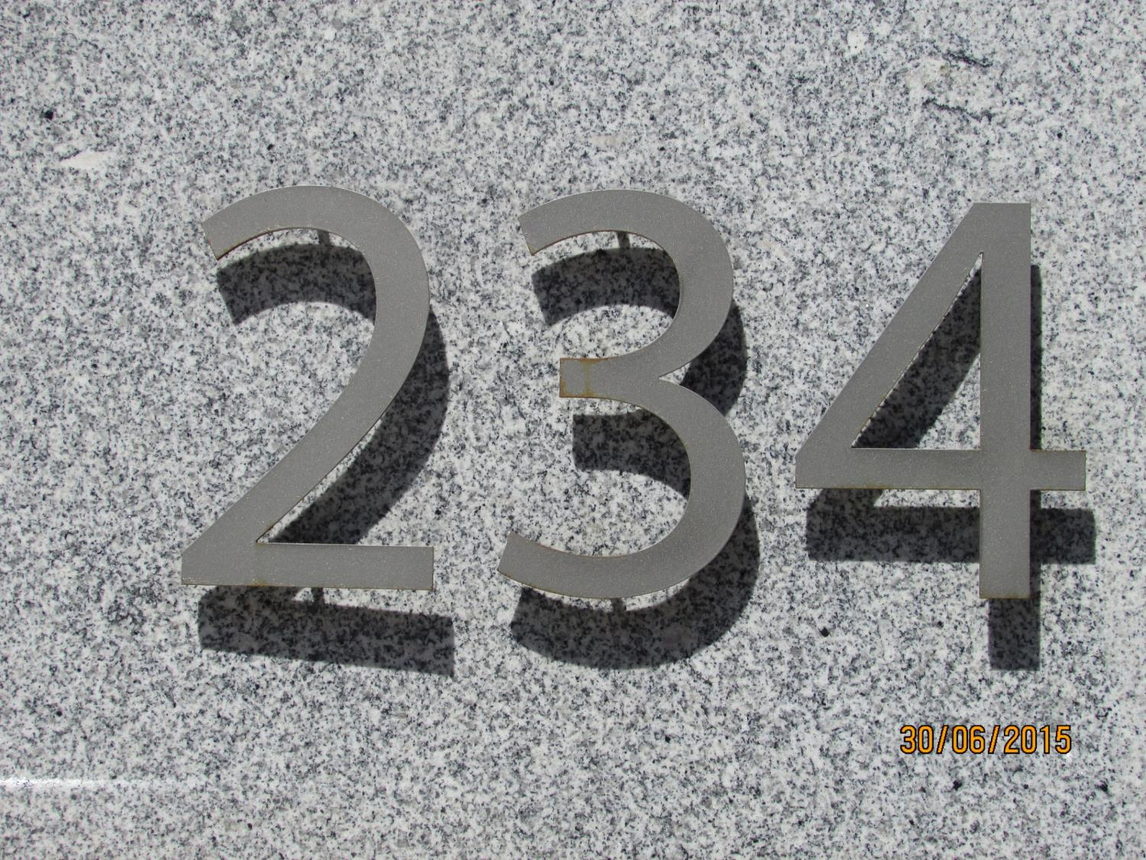

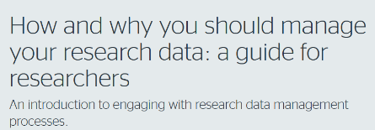
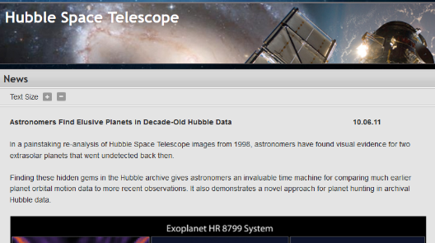

Perché occuparsi dei dati?
JISC Guide
EVITARE DI PERDERLI
ORGANIZZARLI PER RENDERE PIÙ EFFICACE LA RICERCA
(SE APERTI)
ESSERE PIÙ VISIBILI
ALCUNI SONO UNICI E IRRIPETIBILI (meteorologia)
PERMETTERE VALIDAZIONE E CONTROLLI
(SE APERTI)
FAVORIRE COLLABORAZIONI
MIGLIORARE INTEGRITÀ DELLA RICERCA
(SE APERTI)
FAVORIRE RIUSO INEDITO
ESSERE RIPRODUCIBILI
«the coolest thing to do with your data will be thought of by someone else» [R.Pollock]

Slide 8
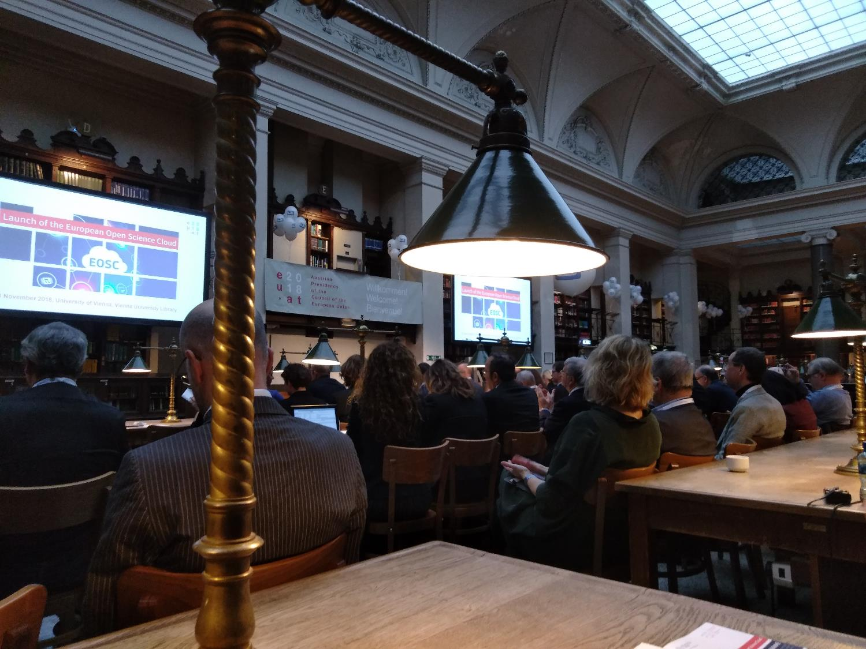
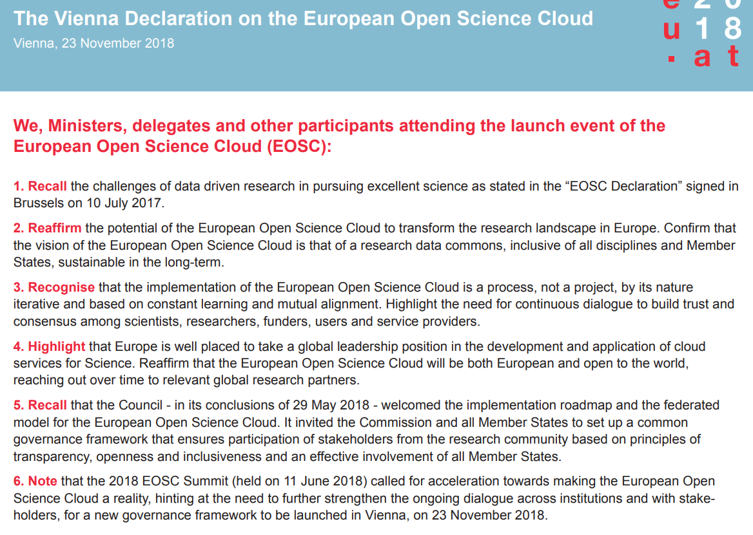
Perché occuparci dei dati?
Vienna, 23 novembre 2018
PERCHÉ ORA ABBIAMO EOSC
Vienna, Nov.23, 2018
SEAMLESS ACCESS TO OPEN BY DEFAULT FAIR DATA

Slide 9

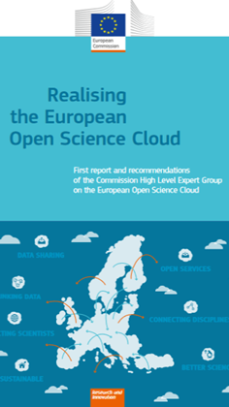
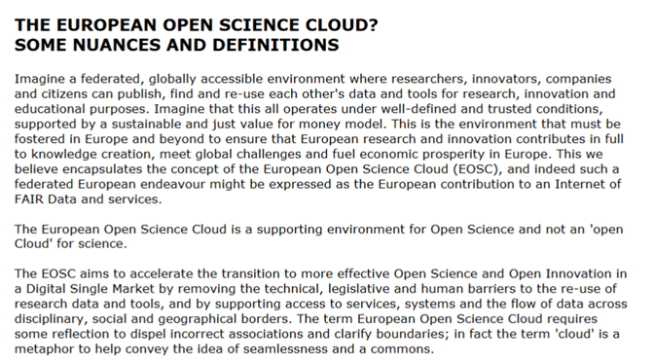
[EOSC – cioè?]
2016

Slide 10

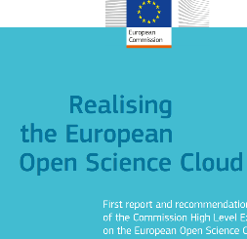
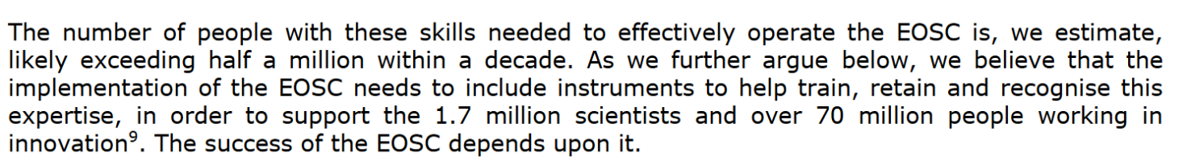
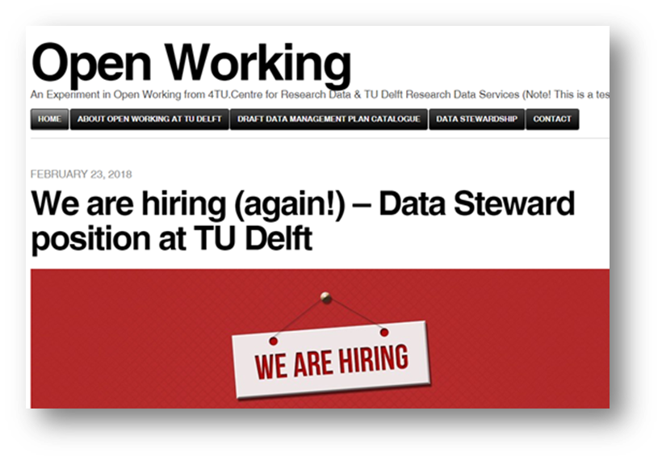
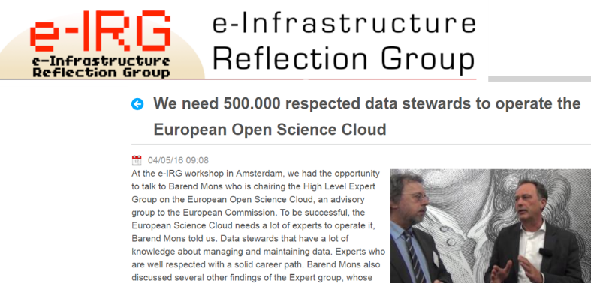
[EOSC è anche data stewardship]
Report, 2016

Slide 11
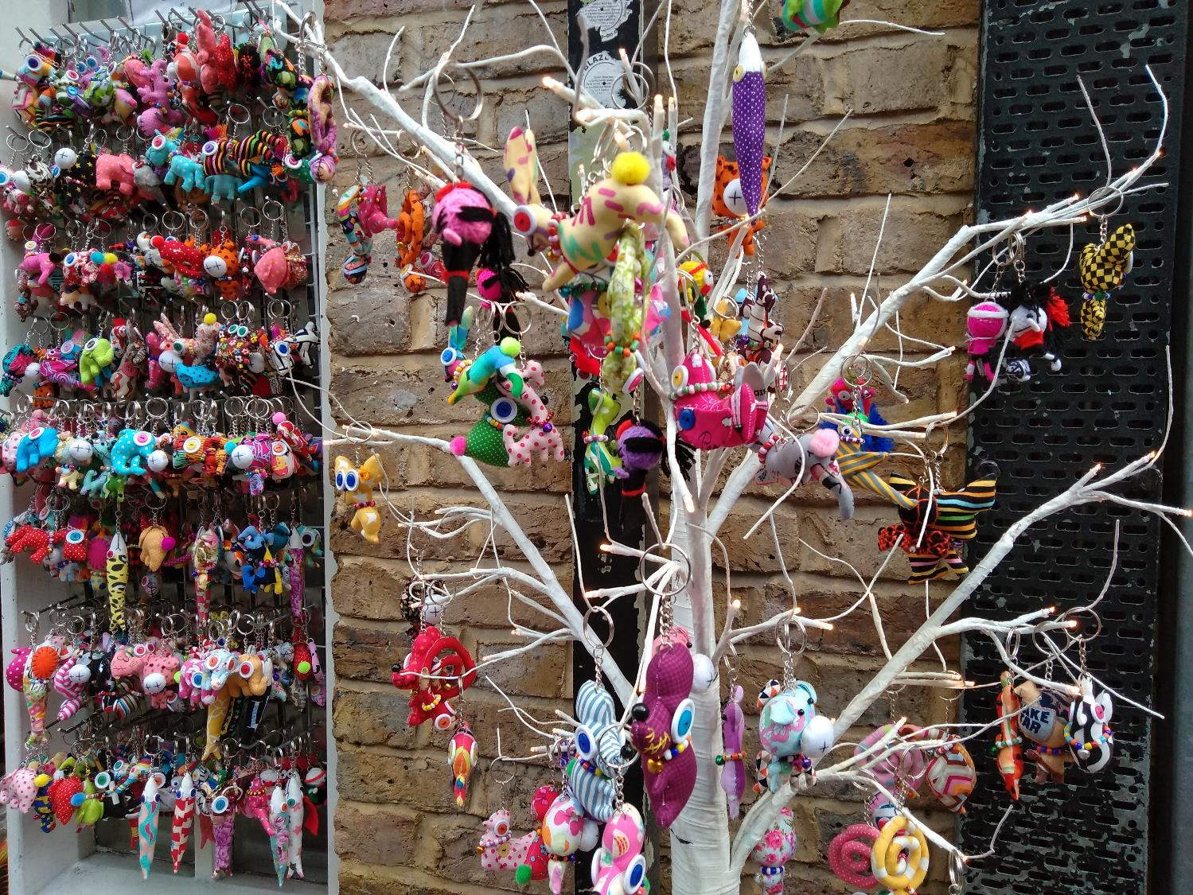
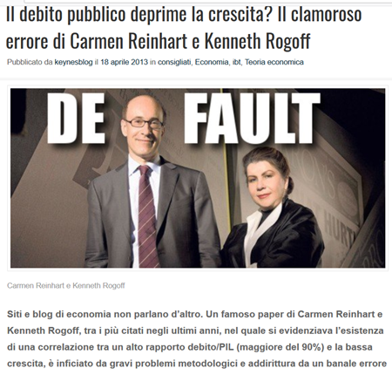
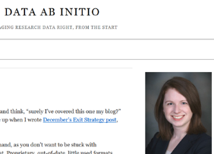
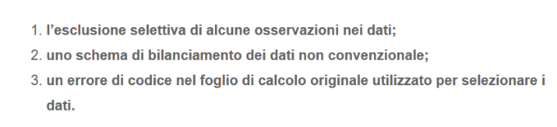
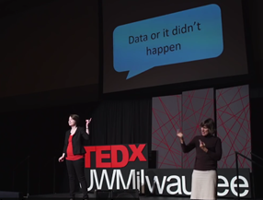
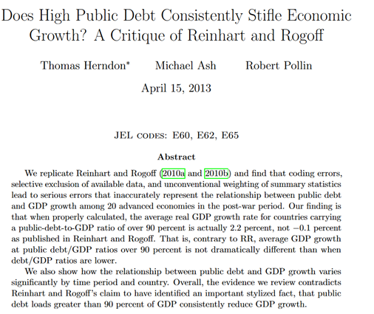
Perché occuparci di dati?
2013
K.Birney, 2015
Herndon, 2013

Slide 12
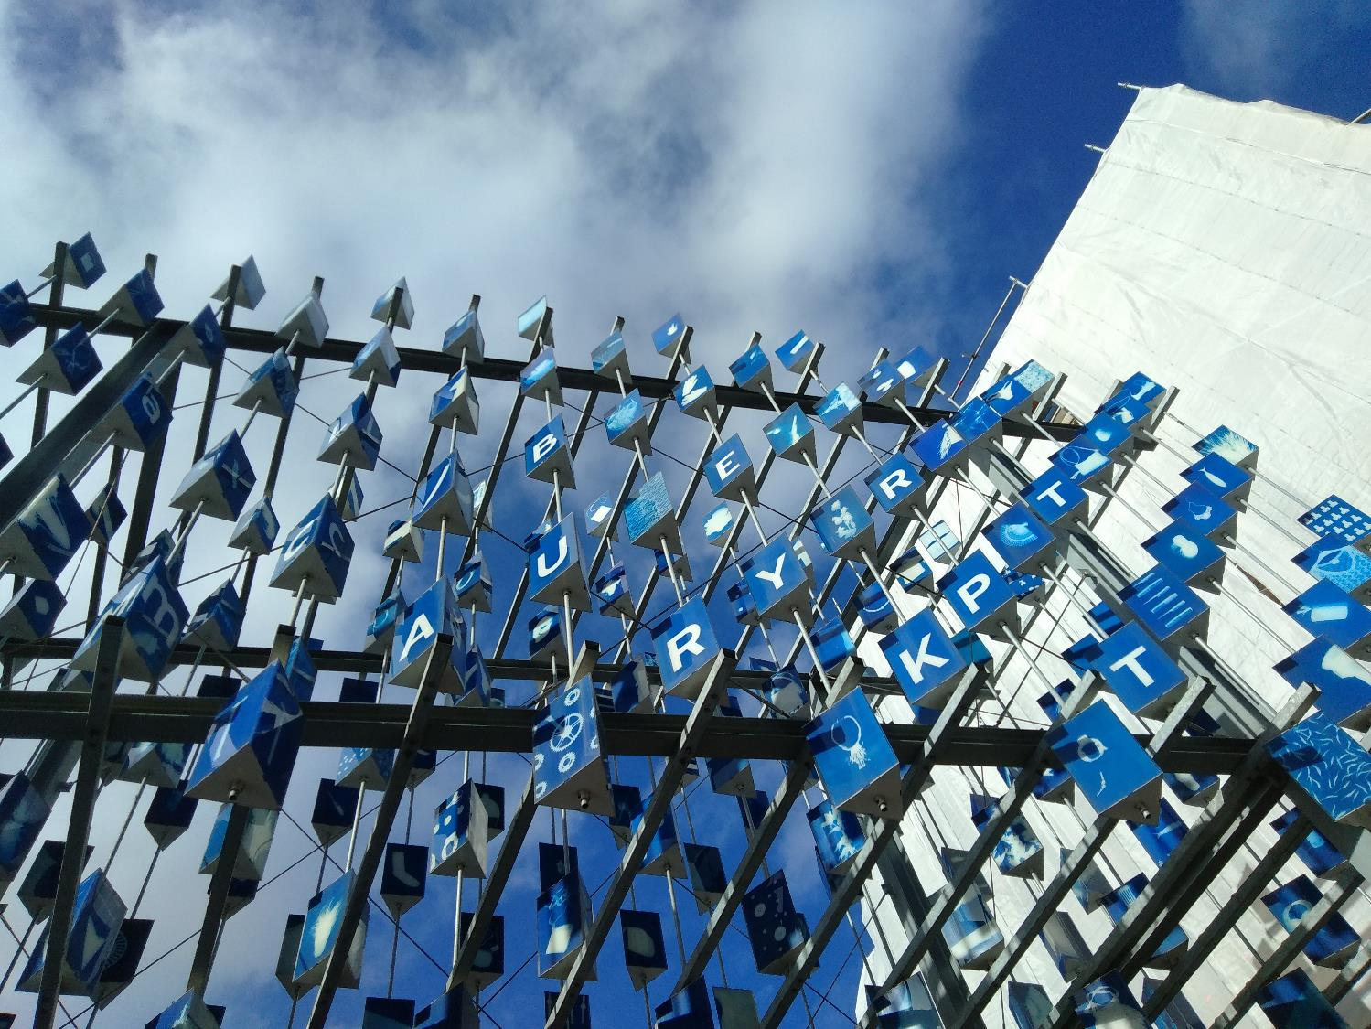

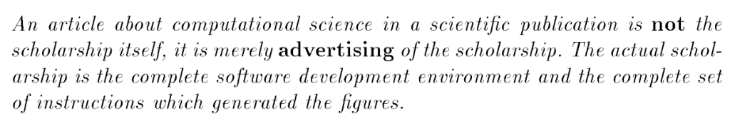
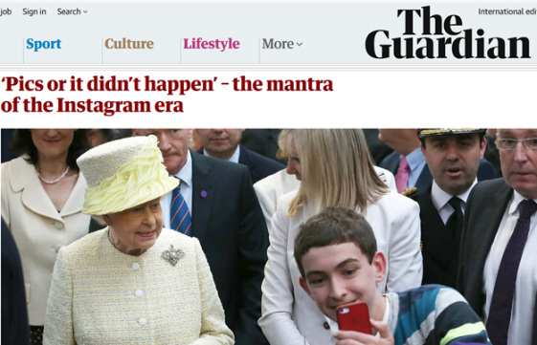
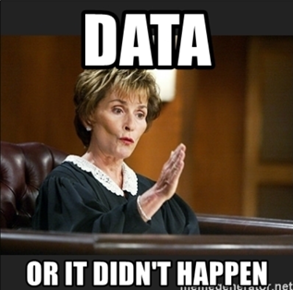
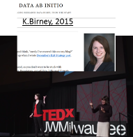
Perché occuparci dei dati?
1995
UN ARTICOLO SENZA I DATI È SOLO LA PUBBLICITÀ DELLA RICERCA
2015
https://memegenerator.net/instance/64979477/case-closed-judge-judy-data-or-it-didnt-happen

Slide 13
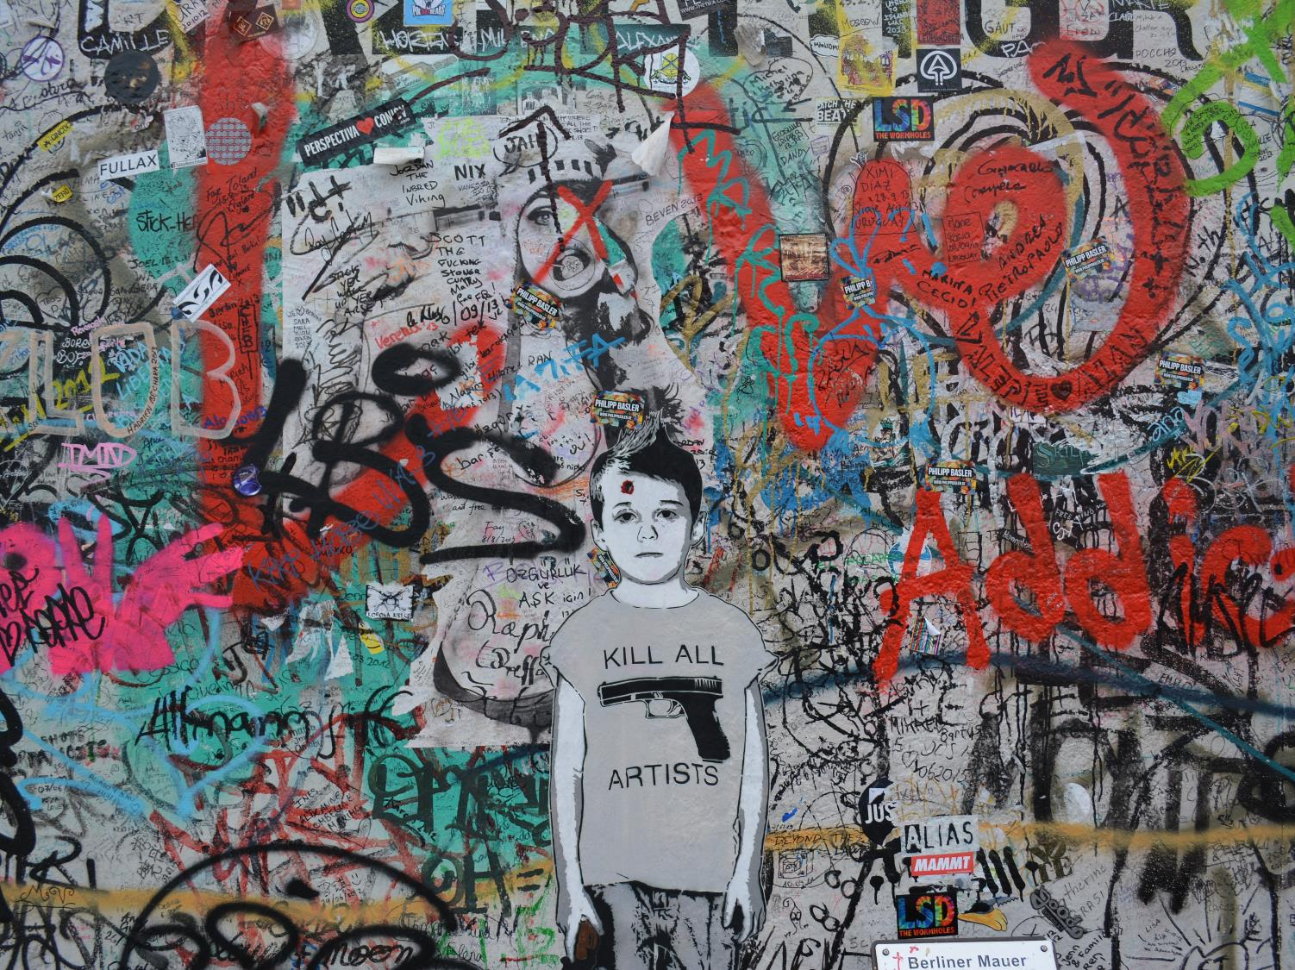
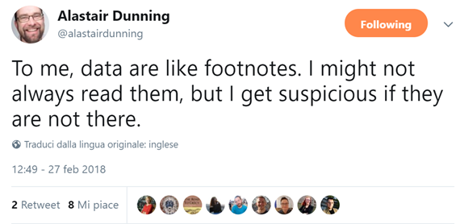
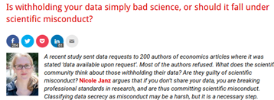
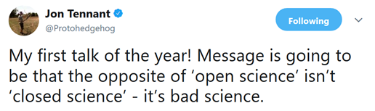
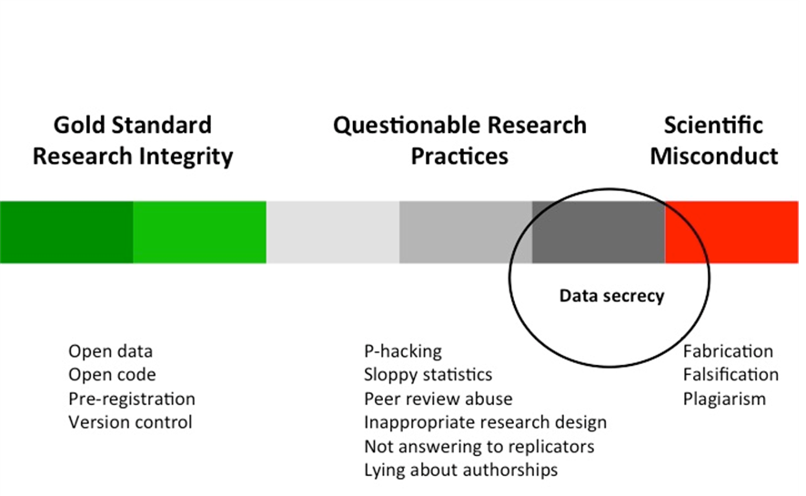
No data?
https://twitter.com/alastairdunning/status/968453078218395648
http://blogs.lse.ac.uk/impactofsocialsciences/2015/07/03/data-secrecy-bad-science-or-scientific-misconduct/

Slide 14
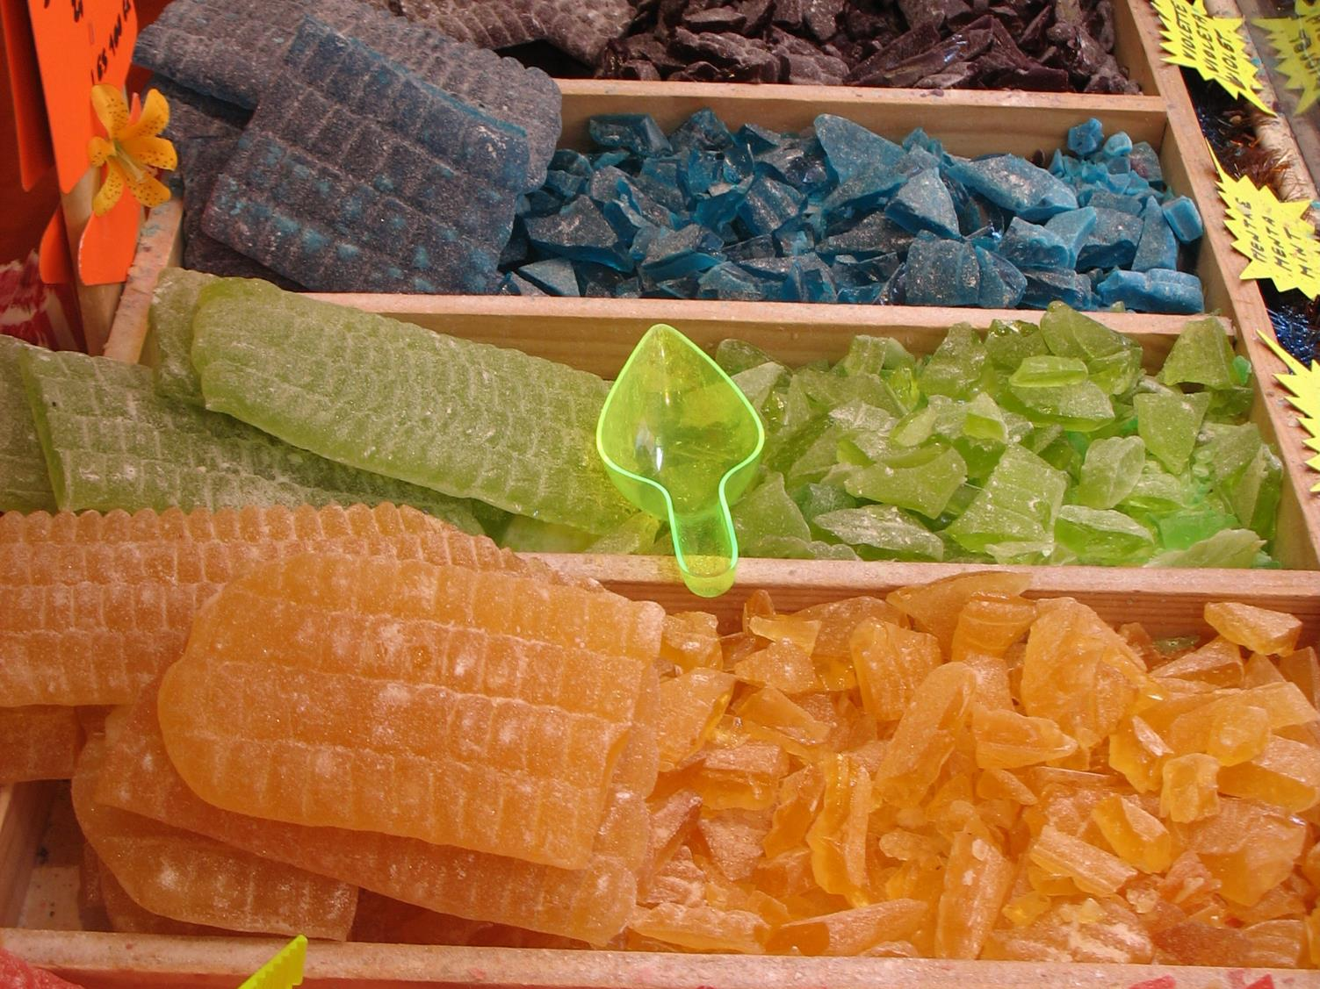
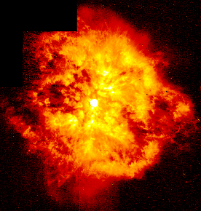
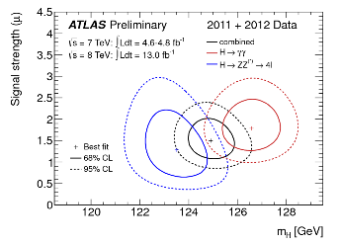
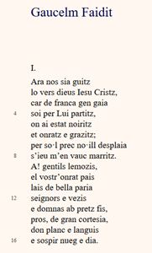
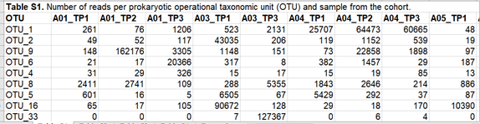
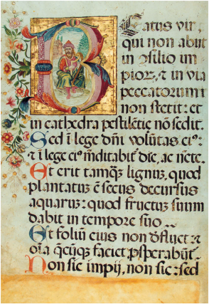

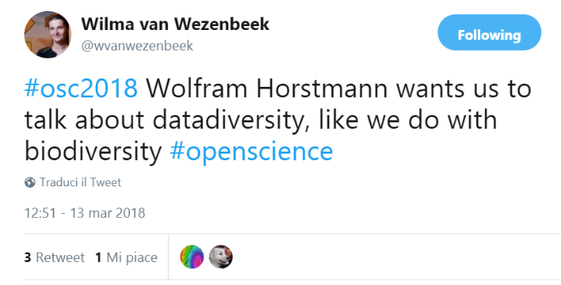
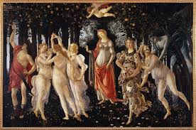
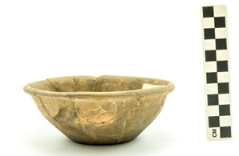
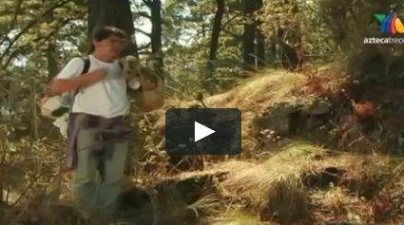
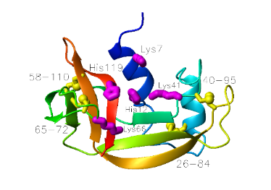
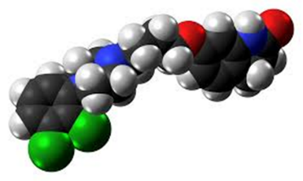
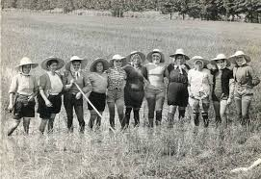
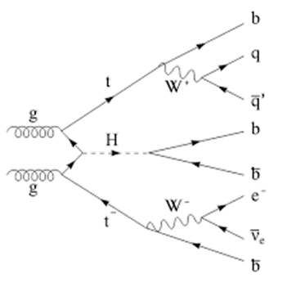
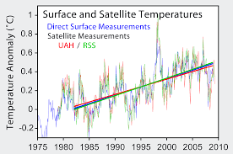
Parliamo di dati
«pezzi»
di conoscenza osservabili
https://twitter.com/wvanwezenbeek/status/973527086685093893

Slide 15
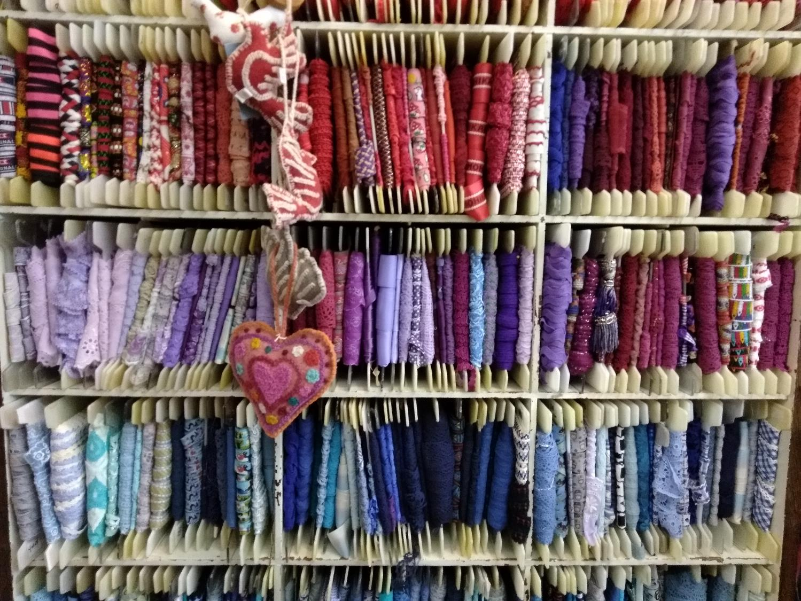



Un po’ di glossario
Essentials4data
http://www.dcc.ac.uk/resources/curation-lifecycle-model

Slide 16



Un po’ di glossario
5 modi per pensare i dati:
come sono raccolti (esperimenti, simulazioni…)
come si presentano (testi, questionari, video…)
il loro formato elettronico (.txt, .mkv…)
il loro volume (big data…)
in che fase sono del ciclo (raw data…)
https://eprints.soton.ac.uk/403440/1/introducing_research_data.pdf

Slide 17




Due pilastri, anzi tre
https://www.ands.org.au/
http://www.dcc.ac.uk/resources

Slide 18







… e un maestro
https://www.taylorfrancis.com/books/9781498753180

Slide 19



…una via veloce
https://vidensportal.deic.dk/RDMelearn
LO STIAMO TRADUCENDO IN ITALIANO

Slide 20


I costi
http://www.curationexchange.org/
CI SONO COSTI PER CONSERVARE E GESTIRE I DATI…
MA PENSIAMO A QUANTO COSTEREBBE
NON CONSERVARLI E NON GESTIRLI

Slide 21




Costi
Data science report, 2016, cit. by Erik Schultes
10,2 bn
16 bn
____________
26,2 bn
Cost of not having FAIR data, 2018
Cost of not having FAIR data, 2018

Slide 22


Costi
DM costing tool

Slide 23

…un passo indietro…

Slide 24





[il fondamento]
http://eprints.gla.ac.uk/171314/
OpenAIRE
I DATI NON SONO «MIEI»
NON ESISTE COPYRIGHT PERCHÉ NON SONO CREATIVI

Slide 25


[ricordandosi che ci sono 3 passi]
Open
FAIR
Gestione/Cura

Slide 26


1. I DATI VANNO CURATI
BACKUP E STORAGE
METADATI
ORGANIZZAZIONE
(file naming, versioning…)
CONSERVAZIONE SUL LUNGO PERIODO
ASPETTI LEGALI

Slide 27




2. I DATI DEVONO ESSERE FAIR
«ACCESIBLE» NON SIGNIFICA «OPEN». SIGNIFICA SOLO DICHIARARE LE CONDIZIONI SECONDO CUI I DATI SONO ACCESSIBILI
https://www.force11.org/group/fairgroup/fairprinciples

Slide 28



3. I DATI POSSONO ESSERE OPEN

Slide 29


1. GESTIONE DEI DATI

Slide 30




… dall’inizio
May 2018
2013

Slide 31





Data Management expert guide
https://www.cessda.eu/Training/Training-Resources/Library/Data-Management-Expert-Guide

Slide 32




[con un servizio pratico]
AL TERMINE DI OGNI MODULO LA SEZIONE «ADAPT YOUR DMP»
VI AIUTA AD APPLICARE I CONCETTI APPRESI
CESSDA Guide

Slide 33



Data management ABC – File naming
https://www.ed.ac.uk/records-management/guidance/records/practical-guidance/naming-conventions

Slide 34




Data management ABC – File naming / 2
Data versioning

Slide 35

Data management ABC – Versioning
https://www2.le.ac.uk/services/research-data/documents/UoL_VersionControlChart_d0-1.pd

Slide 36


Data management ABC – Versioning
CESSDA training

Slide 37



Data Management guide
May 9, 2018
https://www.cessda.eu/Training/Training-Resources/Library/Data-Management-Expert-Guide

Slide 38



Imparare a curare
https://training.parthenos-project.eu/sample-page/manage-improve-and-open-up-your-research-and-data/

Slide 39


Training
https://mantra.edina.ac.uk/

Slide 40




Imparare a gestire
https://www.fosteropenscience.eu/node/2328

Slide 41



Imparare a proteggere

Slide 42




[dati personali]

Slide 43



[Dati e GDPR]
Erasmus University Rotterdam
marlon.domingus@eur.nl
February 2018

Slide 44


The Logic of a Privacy Impact Assessment (PIA) for Academic Research
Q1. Do you process (special categories of) personal data
of (vulnerable) individuals in your research?
YES
Q2. What is the legal ground for this processing?
Lawfulness of Processing
(GDPR*, Article 6, 89):
The individuals participating in your research have freely given their explicit consent for one or more specific purposes.
Your research contributes to a legitimate interest, yet results in no high risks for the individuals participating in the research.
Your research has a scientific, historical or statistical purpose, yet results in no high risks for the individuals participating in the research.
NO
YES
Q3. Is this processing a high risk processing?
Proceed - no measures required for safeguardingprivacy.
Criteria for high risk processing
(WP29 - DPIA Guideline**):
Evaluation or scoring
Automated-decision making with legal or similar significant effect
Systematic monitoring
Sensitive data or data of a highly personal nature
Data processed on a large scale
Matching or combining datasets
Data concerning vulnerable data subjects
Innovative use or applying new technological or organisational solutions
When the processing itself prevents data subjects from exercising a right or using a service or a contract
NO
YES
NO
Stop research or redefine research.
Proceed - measures required for safe-guarding privacy.
"Personal Data" (GDPR*, Article 4):
Any information relating to an identified or identifiable natural person: a name, an identification number, location data, an online identifier, one or more factors specific to the physical, physiological, genetic, mental, economic, cultural or social identity of that natural person.
"Special Categories of Personal Data
(Sensitive Data)" (GDPR, Article 9):
Data revealing racial or ethnic origin, political opinions, religious or philosophical beliefs, or trade union membership, the processing of genetic data, biometric data for the purpose of uniquely identifying a natural person, data concerning health or data concerning a natural person's sex life or sexual orientation.
Action
Data protection by design and by default
(GDPR*, Article 25):
Implement appropriate technical and organisational measures:
Individual participating in your research (data subject). Is the participant well informed, aware of possible risks for her/him and aware of the purpose of the research?
Data. Is the data de-identified and encrypted?
Access Management. How is access managed and controlled for the PI / team (expanded) / public?
Software / Platform. Are the Terms of Service for used software / platform checked (where is the data and who has access and has which usage rights)?
Devices. Are devices used safe? Encrypted drive, encrypted communication, strong password / two factor authentication.
Partners. Are the research partners / service partners trusted and are appropriate legal agreements made, with regards to roles, rights and responsibilities?
Safe and secure collaboration. Is the ((cross border) communication to, in and from the) collaboration platform end to end encrypted, are roles and permissions defined and implemented, is logging and monitoring implemented?
Risk definition and mitigation. Are risks defined and mitigated? Is a risk audit procedure started?
Action
Prior consultation
(GDPR*, Article 36):
The Data Protection Officer shall, on behalf of the researcher, consult the supervisory authority, prior to the processing (the research) when the processing would result in a high risk in the absence of measures to mitigate the risk.
Action
Records of processing activities
(GDPR*, Article 30):
The university shall maintain a digital record
of the processing activities in your research to
demonstrate compliancy to the GDPR.
This register contains:
The name and contact details of the researcher, the research partners and service providers;
The purposes of the processing;
A description of the categories of data subjects and of the categories of personal data;
The categories of recipients to whom the personal data have been or will be disclosed.
Action
Principles relating to processing of personal data (GDPR*, Article 5):
Demonstrate compliancy with the principles:
lawfulness, fairness, transparency, purpose limitation, data minimisation, accuracy, storage limitation, integrity, confidentiality and accountability.
* Regulation (EU) 2016/679 of the European Parliament and of the Council of 27 April 2016 on the protection of natural persons with regard to the processing of personal data and on the free
movement of such data, and repealing Directive 95/46/EC (General Data Protection Regulation). Online available at: http://eur-lex.europa.eu/legal-content/EN/TXT/PDF/?uri=CELEX:32016R0679&from=EN
** Article 29 Data Protection Working Party: Guidelines on Data Protection Impact Assessment (DPIA) and determining whether processing is “likely to result in a high risk” for the purposes of Regulation 2016/679.
Adopted on 4 April 2017. As last Revised and Adopted on 4 October 2017. Online available at: https://ec.europa.eu/newsroom/document.cfm?doc_id=47711

Slide 45


[anonimizzare i dati]
http://catalogue.openaire.eu/service/openaire.amnesia

Slide 46
2. RENDERE I DATI FAIR

Slide 47





…dati FAIR…
FAIR guide, Nature, March 2016
checklist per FAIR
https://www.ands-nectar-rds.org.au/fair-tool
F=METADATI, IDENTIFICATIVI PERSISTENTI…
A= CONSERVAZIONE SUL LUNGO PERIODO
I=FORMATI APERTI, INTEROPERABILI
R=DOCUMENTAZIONE E LICENZE

Slide 48



FAIR in a nutshell
https://www.ands.org.au/working-with-data/fairdata/training

Slide 49




FAIR for dummies
https://www.go-fair.org/fair-principles/
https://www.dtls.nl/fair-data/fair-principles-explained/

Slide 50




FAIR / Open
Turning FAIR into reality, 2018

Slide 51



FAIR data – dati e valutazione
…SMETTETE DI ADORARE
L’ IMPACT FACTOR
…E GLI ARTICOLI. ESISTONO I DATI, SOFTWARE, PROTOCOLLI
…FIRMARE DORA?
Turning FAIR into reality, 2018

Slide 52

3. APRIRE I DATI

Slide 53





Perché Open Data?
Oct. 2017
https://twitter.com/wvanwezenbeek/status/973502457115537408
SHARING DATA
GOOD FOR SCIENCE, GOOD FOR YOU
https://www.youtube.com/watch?v=HJbo-OAaJ1I&feature=youtu.be

Slide 54





Behaviours
http://carlystrasser.net/closed-data-excuses-excuses/

Slide 55


… «as open as possible»…

Slide 56


Open Science: perché solo i dati?

Slide 57

PAUSA?

Slide 58



… a second report from Vienna
Nov. 20, 2018

Slide 59






FAIR data – the ideal FAIR object
Making Open Science a reality, OECD, 2015

Slide 60


FAIR: technology VS domain
CC BY Erik Schultes
https://www.go-fair.org/wp-content/uploads/2018/11/26102018_Country_meeting_GFISCO_staff_presentation.pdf

Slide 61




… quanto siete FAIR?
Training
https://www.ands-nectar-rds.org.au/fair-tool

Slide 62



FAIR maturity evaluator
March 21, 2019
https://linkeddata.systems:3000/
OGGETTIVO
MACHINE-READABLE … COME I DATI FAIR

Slide 63



FAIR Data management wizard

Slide 64



F = Findable. Metadata
https://www.ands.org.au/working-with-data/metadata

Slide 65




F = Findable. Metadata standards
http://rd-alliance.github.io/metadata-directory/standards/

Slide 66



F = Findable. Persistent identifiers
- USATE IL DOI
- USATE ORCID
https://orcid.org/
https://www.datacite.org/

Slide 67


ORCID – ID, ognuno è unico
CREARE E MANTENERE UN ORCID ID FA GIRARE TUTTE QUESTE RUOTE

Slide 68


A = Accessible
ACCESSIBLE≠OPEN
«ACCESS» CAN ALSO BE RESTRICTED OR EMBARGOED
CESSDA Guide

Slide 69







A = Accessible. Data repositories

Slide 70




A = Accessible. Looking for a data repository?
https://www.re3data.org/

Slide 71




A = Accessible. Data journals

Slide 72



A = Accessible. Formati
https://dans.knaw.nl/en/deposit/information-about-depositing-data/before-depositing/file-formats

Slide 73





A = Accessibile / formats [UK Data service]
https://www.ukdataservice.ac.uk/manage-data/format/recommended-formats.aspx

Slide 74









A = Accessible. Conservazione
LONG TERM
OR SHORT TERM?
http://checksumchecker.sourceforge.net/

Slide 75



A = Accessible. Preservation
CESSDA Guide
Different needs, different tools.
During: you need also to share with the team.

Slide 76



Cosa conservare?
How to develop

Slide 77



I = Interoperable. Standards
http://training.parthenos-project.eu/sample-page/intro-to-ri/interoperability/what-are-standards/

Slide 78


I = Interoperable. Standards
http://ssk.huma-num.fr/#/

Slide 79




I = Interoperable
2019

Slide 80




[FAIRsharing / Interoperability]
https://fairsharing.org

Slide 81



R = Riusabile. Documentazione
http://datasupport.researchdata.nl/en/start-the-course/iii-the-research-phase/data-documentation/
PER ESSERE RIUSABILI I DATI DEVONO AVERE
DOCUMENTAZIONE
LICENZE

Slide 82


R = Reusable. Documentazione
https://www.cessda.eu/Training/Training-Resources/Library/Data-Management-Expert-Guide/2.-Organise-Document/Documentation-and-metadata

Slide 83








R = Reusable. Documentation
http://jupyter.org/index.html
https://www.rstudio.com/
…WHY NOT?
PROTOCOLS.IO
OPEN LAB NOTEBOOK
PER TENERE TRACCIA DI TUTTO L’ESPERIMENTO
[DIFFICILE ALL’INIZIO, POI TUTTO FATTO…]

Slide 84





R= Reusable. Licenze
Copyright: protects the STRUCTURE, selection or arrangement of their contents" (Art. 3) NOT THE DATA
Sui generis database right: protects the «substantial effort» in OBTAINING data [NOT «CREATING»]… the right owner often is the institution
Database=a collection of independent works, data or other materials arranged in a systematic or methodical way (Art.1)
RICORDA: NESSUN COPYRIGHT SUI DATI (NON CREATIVI)
2014

Slide 85



[webinar]

Slide 86




[non suoniamo tutti la stessa musica]
CESSDA guide

Slide 87


[regole chiare dall’inizio]
Safe to be open 2016
… FISSATE REGOLE CHIARE DA SUBITO
CHI HA I DIRITTI SUI DATI (SE ESISTE)
CHI DEVE PROVVEDERE A CONSERVARE
CHI PUÒ SFRUTTARE

Slide 88







R = Reusable. Licenze

Slide 89



Creative Commons e Open Science
https://doi.org/10.5281/zenodo.840651

Slide 90



Creative Commons e Open Science
USARE CC0
CHIEDERE CHE VENGA DATO CREDITO ALL’AUTORE
PROPORRE GIÀ LA CITAZIONE-TIPO
(non citare la fonte è scorretto scientificamente)

Slide 91


DOVE METTERE TUTTE QUESTE INFORMAZIONI? NEL DATA MANAGEMENT PLAN
UN MODO STRUTTURATO DI PENSARE AI DATI
REGOLE CHIARE=MENO ERRORI DA SUBITO
È UN «LIVING DOCUMENT»,
CRESCE COL PROGETTO
FOSTER toolkit

Slide 92



Vantaggi di un DMP
CESSDA Guide
CESSDA Guide

Slide 93





DMP Core Requirements
Dec. 2018

Slide 94


DMP Core Requirements
Dec. 2018

Slide 95



DMP Core Requirements
Dec. 2018

Slide 96




DMP questions
https://www.cessda.eu/content/download/4302/48656/file/TTT_DO_DMPExpertGuide_v1.2.pdf

Slide 97




DMP - questions
https://fair-dom.org/knowledgehub/data-management-checklist/

Slide 98


DMP - questions

Slide 99



DMP online
PERSONALIZZABILE
https://dmponline.dcc.ac.uk/

Slide 100






Open data – H2020
Guide 2016
IN HORIZON 2020
DMP ENTRO M6 COME DELIVERABLE

Slide 101

… buon lavoro!

